Slide 1

News Summary Agent
Rakhee Chhibber

Slide 2
WorkFlow
Takes a news article URL.
Downloads and parses the article using newspaper3k.
Splits the article into smaller chunks (to respect transformer model token limits).
Summarizes each chunk using the DistilBART model (sshleifer/distilbart-cnn-12-6).
Returns a concise summary of the article.

Slide 3
sshleifer/distilbart-cnn-12-6
The model sshleifer/distilbart-cnn-12-6 is a distilled version of BART fine-tuned for abstractive text summarization, particularly on CNN/DailyMail news articles

Slide 4
📘 What is BART?
BART (Bidirectional and Auto-Regressive Transformer) is a sequence-to-sequence model developed by Facebook AI.
It combines:
BERT-like encoder (good at understanding context)
GPT-like decoder (good at generating fluent text)

Slide 5
🔹 2. What is DistilBART?
🔧 Distillation:
Distillation is a process of compressing a large model into a smaller, faster, and cheaper model without a significant drop in performance.
sshleifer/distilbart-cnn-12-6 is a distilled version of facebook/bart-large-cnn, created by Sam Shleifer (GitHub: sshleifer).

Slide 6
🔢 What does cnn-12-6 mean?
cnn: The model is fine-tuned on CNN/DailyMail dataset (a common summarization dataset).
12-6:
Original bart-large has 12 encoder and 12 decoder layers.
Distilled version has 6 encoder and 6 decoder layers → hence 12-6 total layers.

Slide 7
🔹 3. Model Card Summary
Model | sshleifer/distilbart-cnn-12-6
Type | Distilled Sequence-to-Sequence Transformer
Architecture | Encoder-decoder (Transformer-based)
Trained on | CNN/DailyMail summarization dataset
Size | ~400MB (vs ~1.6GB for BART-Large)
Task | Abstractive Summarization
Performance | Slightly lower than bart-large-cnn, but faster and smaller
License | MIT

Slide 8
newspaper3k: for extracting text from news websites.
transformers: for using pretrained language models.
torch: the backend deep learning framework.
streamlit: for creating a web interface (optional, not used here directly).

Slide 9
transformers – For text summarization (e.g., BART, T5)
KeyBERT – For extracting top keywords
Streamlit – Web UI
sqlite3 – For local database storage
pandas – For history table + export
datetime, os, etc. – Misc support
🔹 Likely Libraries Used

Slide 10
Summarization Model
Loads a pretrained summarization model: DistilBART, a smaller and faster version of BART fine-tuned on the CNN/DailyMail dataset.
✅ Pros: Lightweight, fast, works well for extractive-style summarization.
⚠️ Limitation: Can handle up to ~1024 tokens at a time → hence, chunking is necessary.

Slide 11
🔍 Model Used: DistilBART
DistilBART is a smaller and faster version of Facebook’s BART model.
It's fine-tuned on the CNN/DailyMail dataset, which contains news articles and human-written summaries.
Used in the pipeline: pipeline("summarization", model="sshleifer/distilbart-cnn-12-6")

Slide 12
⚙️ Variants & Famous Transformer Models:
Model | Purpose | Notes
BERT | Encoder-only | Bidirectional context
GPT | Decoder-only | Causal language model
T5 | Encoder-Decoder | Text-to-text framework
BART | Encoder-Decoder | Denoising autoencoder
ViT | Vision Transformer | Patches as tokens
Whisper | Audio → Text | OpenAI model for speech

Slide 13
🎯 Where is the Transformer Used?
✅ 1. NLP Tasks:
Text Summarization: (e.g. BART, T5, PEGASUS)
Machine Translation: (e.g. Google Translate uses Transformer)
Question Answering: (BERT, RoBERTa)
Text Classification: (DistilBERT)
Chatbots & Conversational AI: (ChatGPT, Claude, LLaMA)
✅ 2. Multimodal Tasks:
Image Captioning (Vision + Language)
Video Understanding
Audio Transcription (like Whisper)

Slide 14
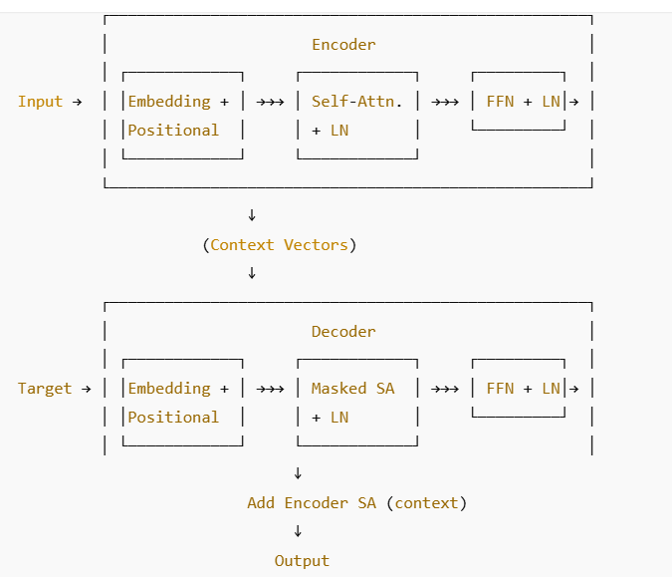
Legend:
SA: Self-Attention
FFN: Feed Forward Network
LN: Layer Normalization
Positional Encoding: Adds order info to tokens
Masked SA: Prevents looking ahead during training (used in decoder)

Slide 15
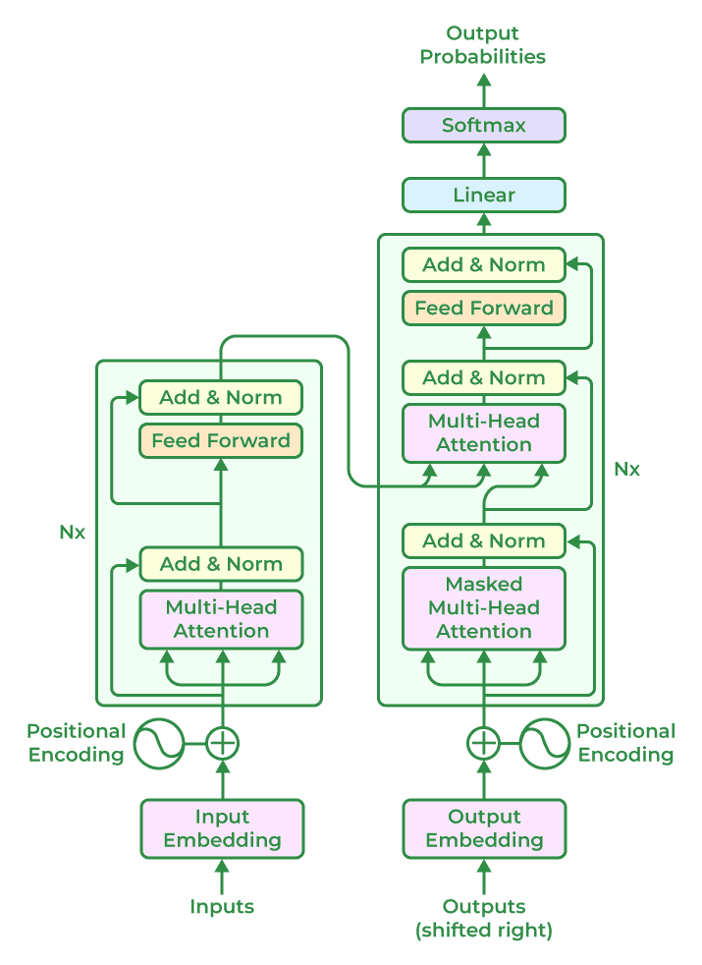
Transformer-Based LLM Model Architectures

Slide 16
🧰 Tech Stack Overview
Layer | Tool / Library | Purpose
Language | Python | Core programming language
NLP Toolkit | nltk | Sentence tokenization (used internally by newspaper3k)
Web Scraping | newspaper3k | Downloading and parsing news articles from a given URL
Transformers | transformers (by Hugging Face) | For loading and using pretrained models (summarization pipeline)
Deep Learning | torch | Backend engine for running transformer models
Summarization Model | sshleifer/distilbart-cnn-12-6 | Pretrained lightweight abstractive summarization model
Chunking Logic | Custom Python function | To split long text into smaller chunks for transformer input
Optional UI | streamlit (commented out) | For building a user interface for the summarization tool

Slide 17
Component | Description
Model Name | sshleifer/distilbart-cnn-12-6
Model Type | Transformer encoder-decoder
Based On | DistilBART (lightweight BART)
Pretrained On | CNN/DailyMail news summary dataset
Token Limit | ~1024 tokens
Pipeline Used | pipeline("summarization", model=...)
Model Type | Transformer (Encoder-Decoder)
🧠 Model-Specific Details

Slide 18
Feature | Tool / Library
Keyword Extraction | keybert, spaCy
Topic Classification | facebook/bart-large-mnli
Data Storage | SQLite, TinyDB
Exporting Reports | pandas, xlsxwriter, fpdf
Web App Interface | streamlit, Flask, Gradio
Deployment | Streamlit Cloud, Render, Hugging Face Spaces
🔄 Optional Add-Ons
You could extend this stack with the following:

Slide 19
🔹 Workflow Summary
User input (e.g., news URL or text) through Streamlit UI
Article fetched and cleaned
Summarizer model generates a summary
Zero-shot classifier tags relevant topics
KeyBERT extracts keywords
Result shown on screen and stored in summaries.db
User can export to CSV/Excel or view past summaries

Slide 20
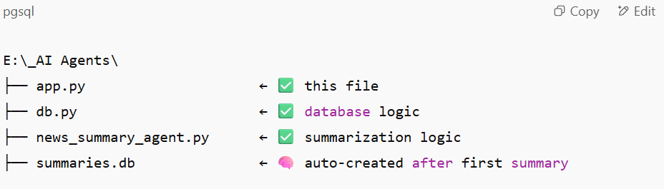
Structure of project

